Slide 1
advanced programming tutorial 6
October 19, 2018
Pieter Koopman

Slide 2
questionnaires
:: Question =
{question :: String
,answers :: [String]
,correct :: Int
}
derive class iTask Question
questions :: Shared [Question]
questions = sharedStore "questions" []

Slide 3
main task
mainTask :: (String, Function) -> Task [Question]
mainTask (user, role) =
case role of
Student = studentTask user
Teacher = teacherTask user
Admin = updateSharedInformation "Admin view" [] questions
_ = abort "unknown role"

Slide 4
name task
nameTask :: ((String, Function) -> Task a) -> Task a | iTask a
nameTask task
= (enterInformation "enter your name" [] -&&- updateInformation "select role" [] Student)
>>* [OnAction ActionOk
(ifValue (\(name, role).size name > 2) task)
]

Slide 5
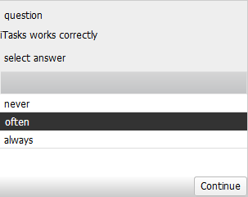
student task

Slide 6
student task
﻿studentTask name
= get questions >>= \list. answer list 0 0 where
answer [] correct wrong
= viewInformation (name + " answered " + toString correct +
" questions correct and " + toString wrong + " questions wrong")
[] []
answer [q:rest] correct wrong
= viewInformation "question" [] q.question
||- editChoice "select answer"
[ChooseFromGrid snd] [(i,a) \\ i <- [1..] & a <- q.answers] Nothing
>>= \(i, a).
if (i == q.correct)
(answer rest (correct + 1) wrong)
(answer rest correct (wrong + 1))

Slide 7
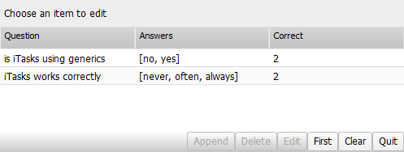
teacher task

Slide 8
teacher task
﻿editSharedList :: (Shared [a]) -> Task [a] | iTask a
editSharedList store
= enterChoiceWithShared "Choose an item to edit"
[ChooseFromGrid snd]
(mapRead (\ps -> [(i,p) \\ p <- ps & i <- [0..]]) store)
>>* [ OnAction (Action "Append") (hasValue (showAndDo append))
, OnAction (Action "Delete") (hasValue (showAndDo delete))
, OnAction (Action "Edit") (hasValue (showAndDo edit))
, OnAction (Action "First") (always (showAndDo first undef))
, OnAction (Action "Clear") (always (showAndDo append
(-1,undef)))
, OnAction (Action "Quit") (always (get store))
]

Slide 9
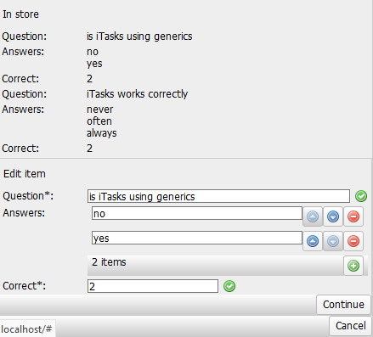
show and do

Slide 10
teacher task 2
﻿showAndDo fun ip
= viewSharedInformation "In store" [] store
||- fun ip
>>* [ OnValue (hasValue (\_ -> editSharedList store))
, OnAction (Action "Cancel") (always (editSharedList store)) ]
append (i,_)
= enterInformation "Add new item" []
>>= \n . upd (\ps .
let (begin, end) = splitAt (i + 1) ps
in begin ++ [n] ++ end) store

Slide 11
teacher task 3
delete (i, _)
= upd (removeAt i) store
first _
= enterInformation "Add new item" []
>>= \n . upd (\l . [n: l]) store
edit (i, p)
= updateInformation "Edit item" [] p
>>= \p . upd (\ps . updateAt i p ps) store

Slide 12
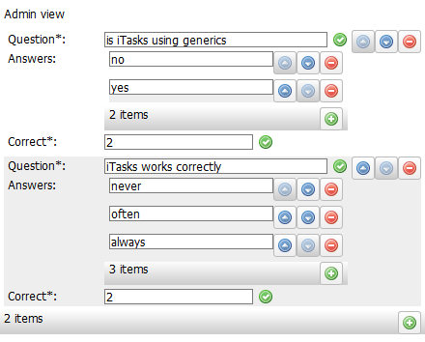
admin

Slide 13
getting the work done

Slide 14
improving your final mark
this assignment can improve your final mark for this course
no effect if the exam result is better than this assignment
only if exam result ≥ 5
weight of this assignment will be 25%
it must be your own work
working with a partner is allowed
just a reward to stimulate you to make the assignment
no lectures in the next two weeks

